Slide 1
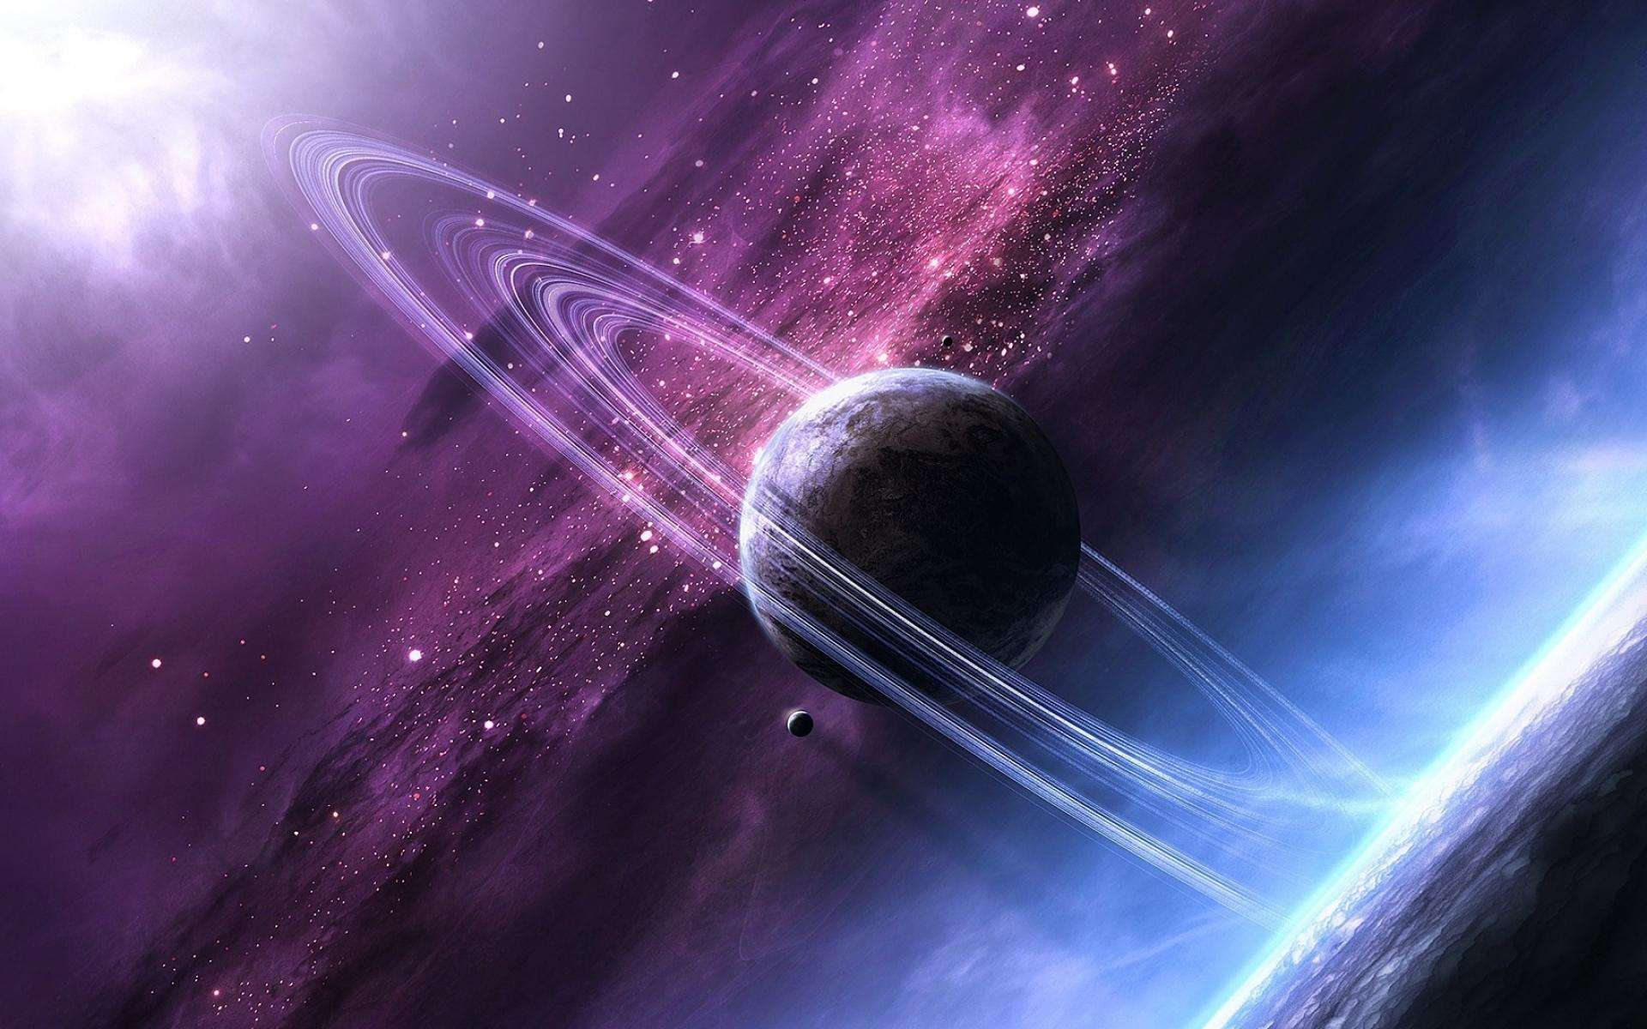

张鸿琳
Department of Physics

Slide 2


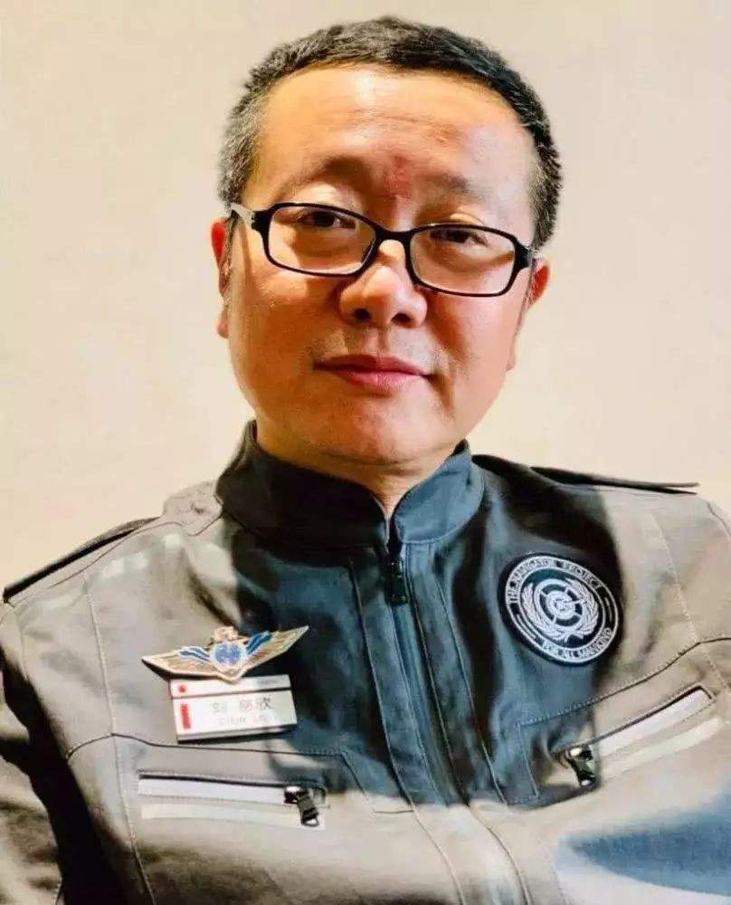
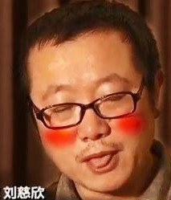
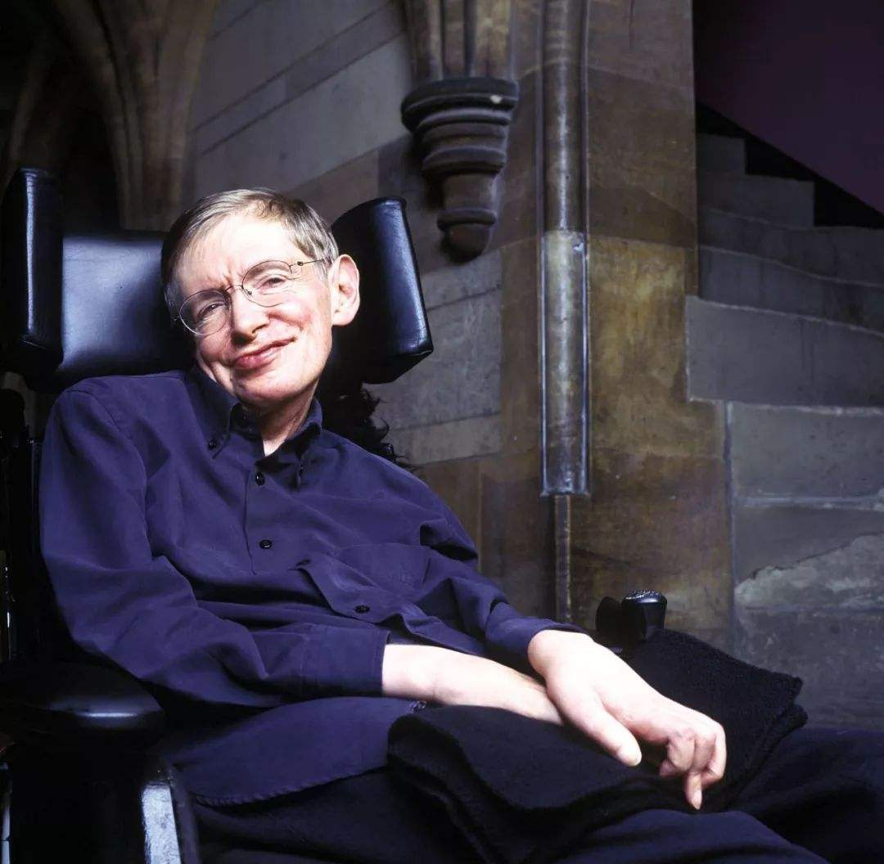

刘慈欣
The author
Who has won this award before？
A Shanxi people born in Beijing whose ancestral home (祖籍）is Henan
57 years old (born in 1963)
A senior engineer
Some representative works:
《Three Body》
《The Wandering Earth》
《Mirror》
《The Collapse of the Universe》
……
Awards:
Galaxy Award（China）
Hugo Award（US）
Clarke Award（US）
Mr.Hawking
NASA（美国国家航空航天局）
Notes:
当前页面由口袋动画“MonkeyText”特效功能，一键生成。 更多动画特效、福利、资源，请搜索、关注访问口袋动画.
官网主页：www.papocket.com

Slide 3
《Three Body》
Why do I like it?
What does it tell؟
What are my ideas about it¿

Slide 4
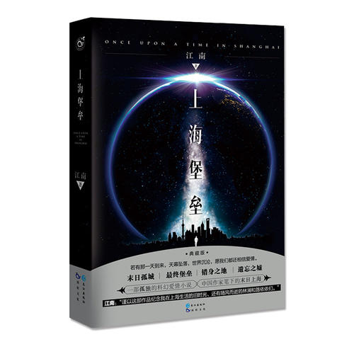
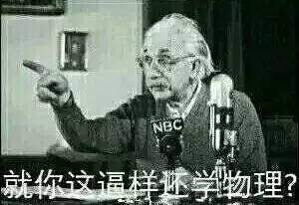
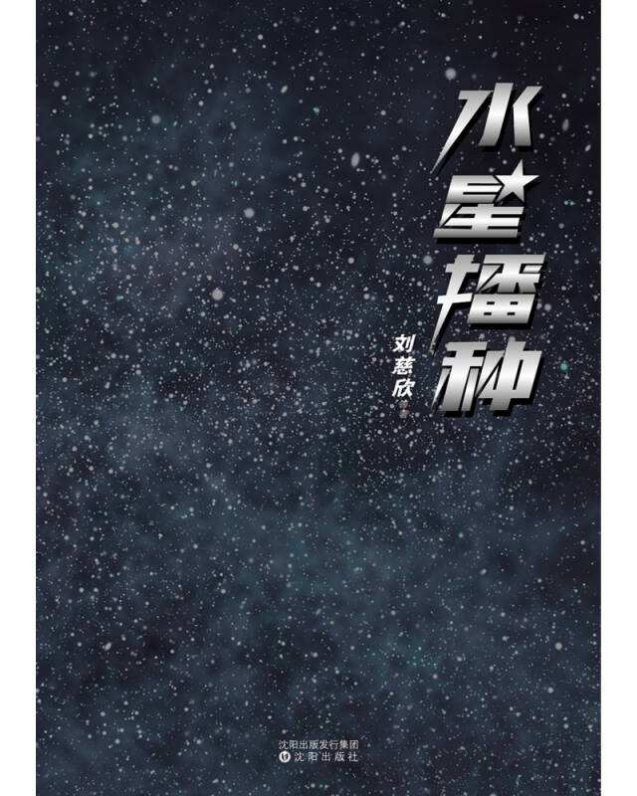
Compared with novels by other Chinese writers,it’s more logical
My enthusiasm about scientific theories and meticulous reasoning

Slide 5
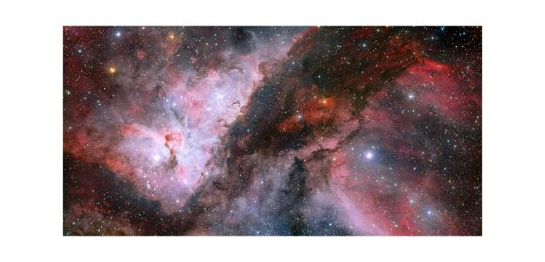
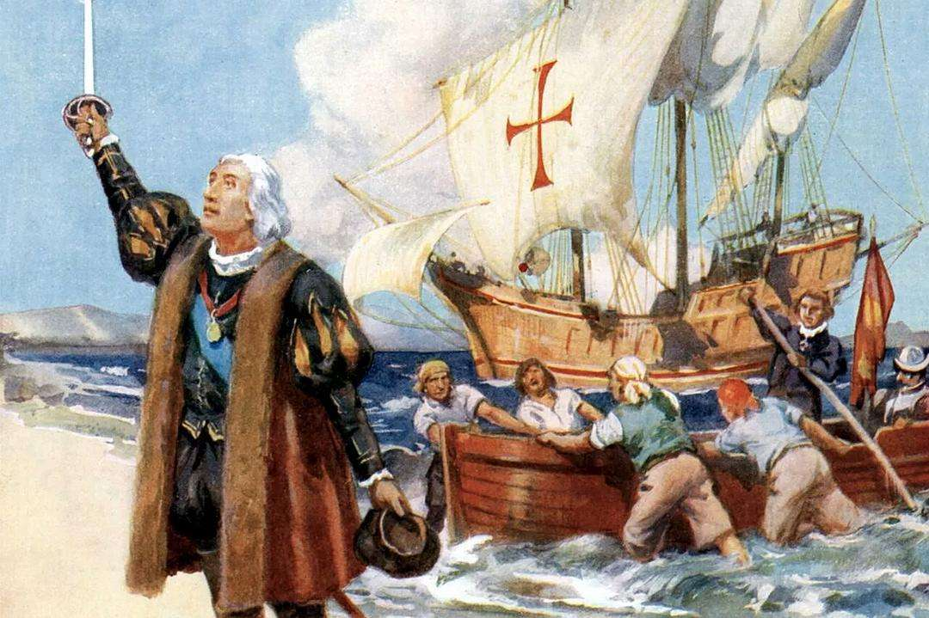
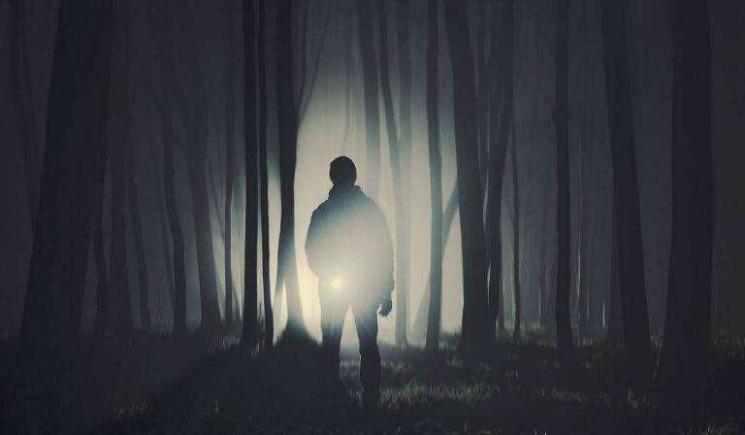
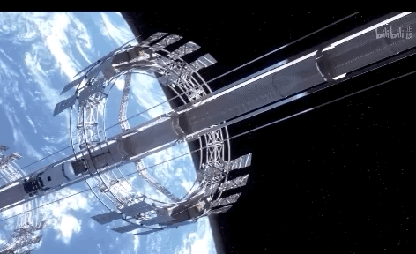
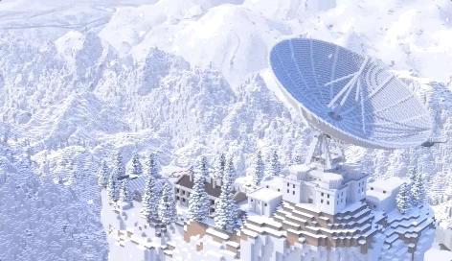
The story:An alien civilization called Three Body detects the existence of earth and is going to invade earth for survival,so we human being come up with varieties of plans to beat them,which last several centuries
A famous conclusion:The Dark Forest Rule
Dark Forest Rule:There's limited matter in the universe and survival is the most important goal for any culture. So any civilization is like a hunter in a dark forest.

Slide 6
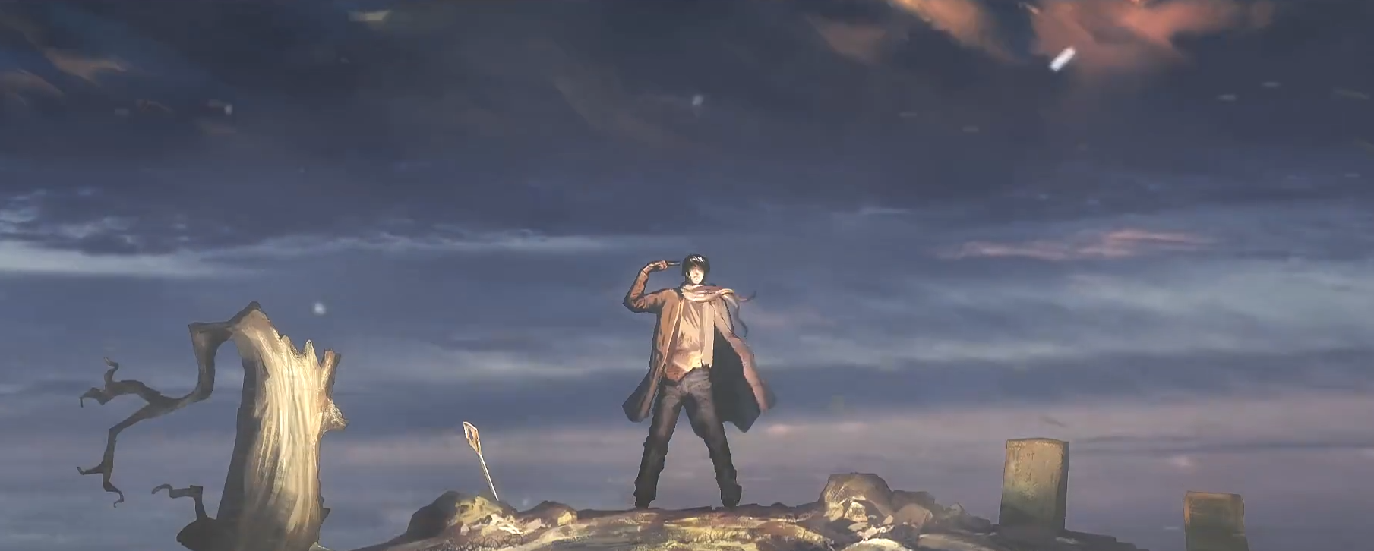
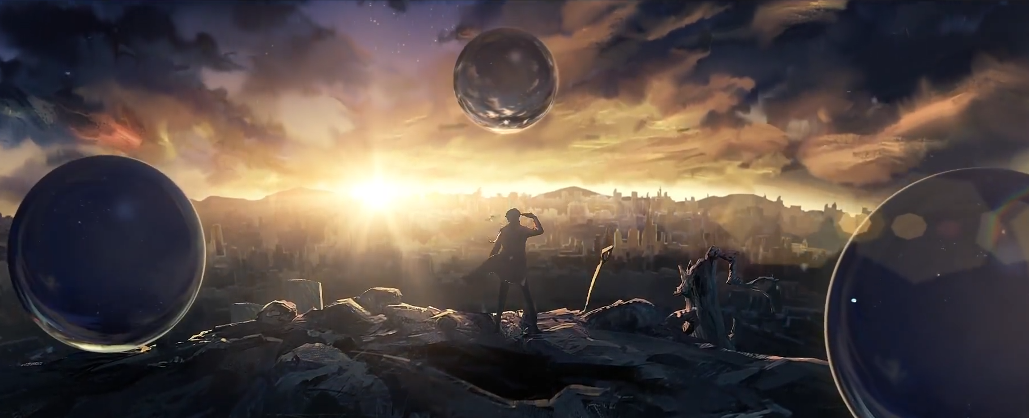
“我，面壁者罗辑，对三体世界说话。”
“The sun is about to set,aren’t your children afraid?”
“No,because they know the sun will rise.”

